Slide 1
10 Steps for your pizzeria ___________________________________________________________________ Good to Incredible
#1
Building High Performing Teams

Slide 2
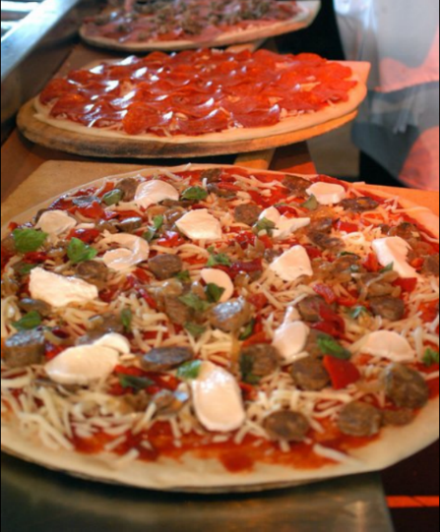
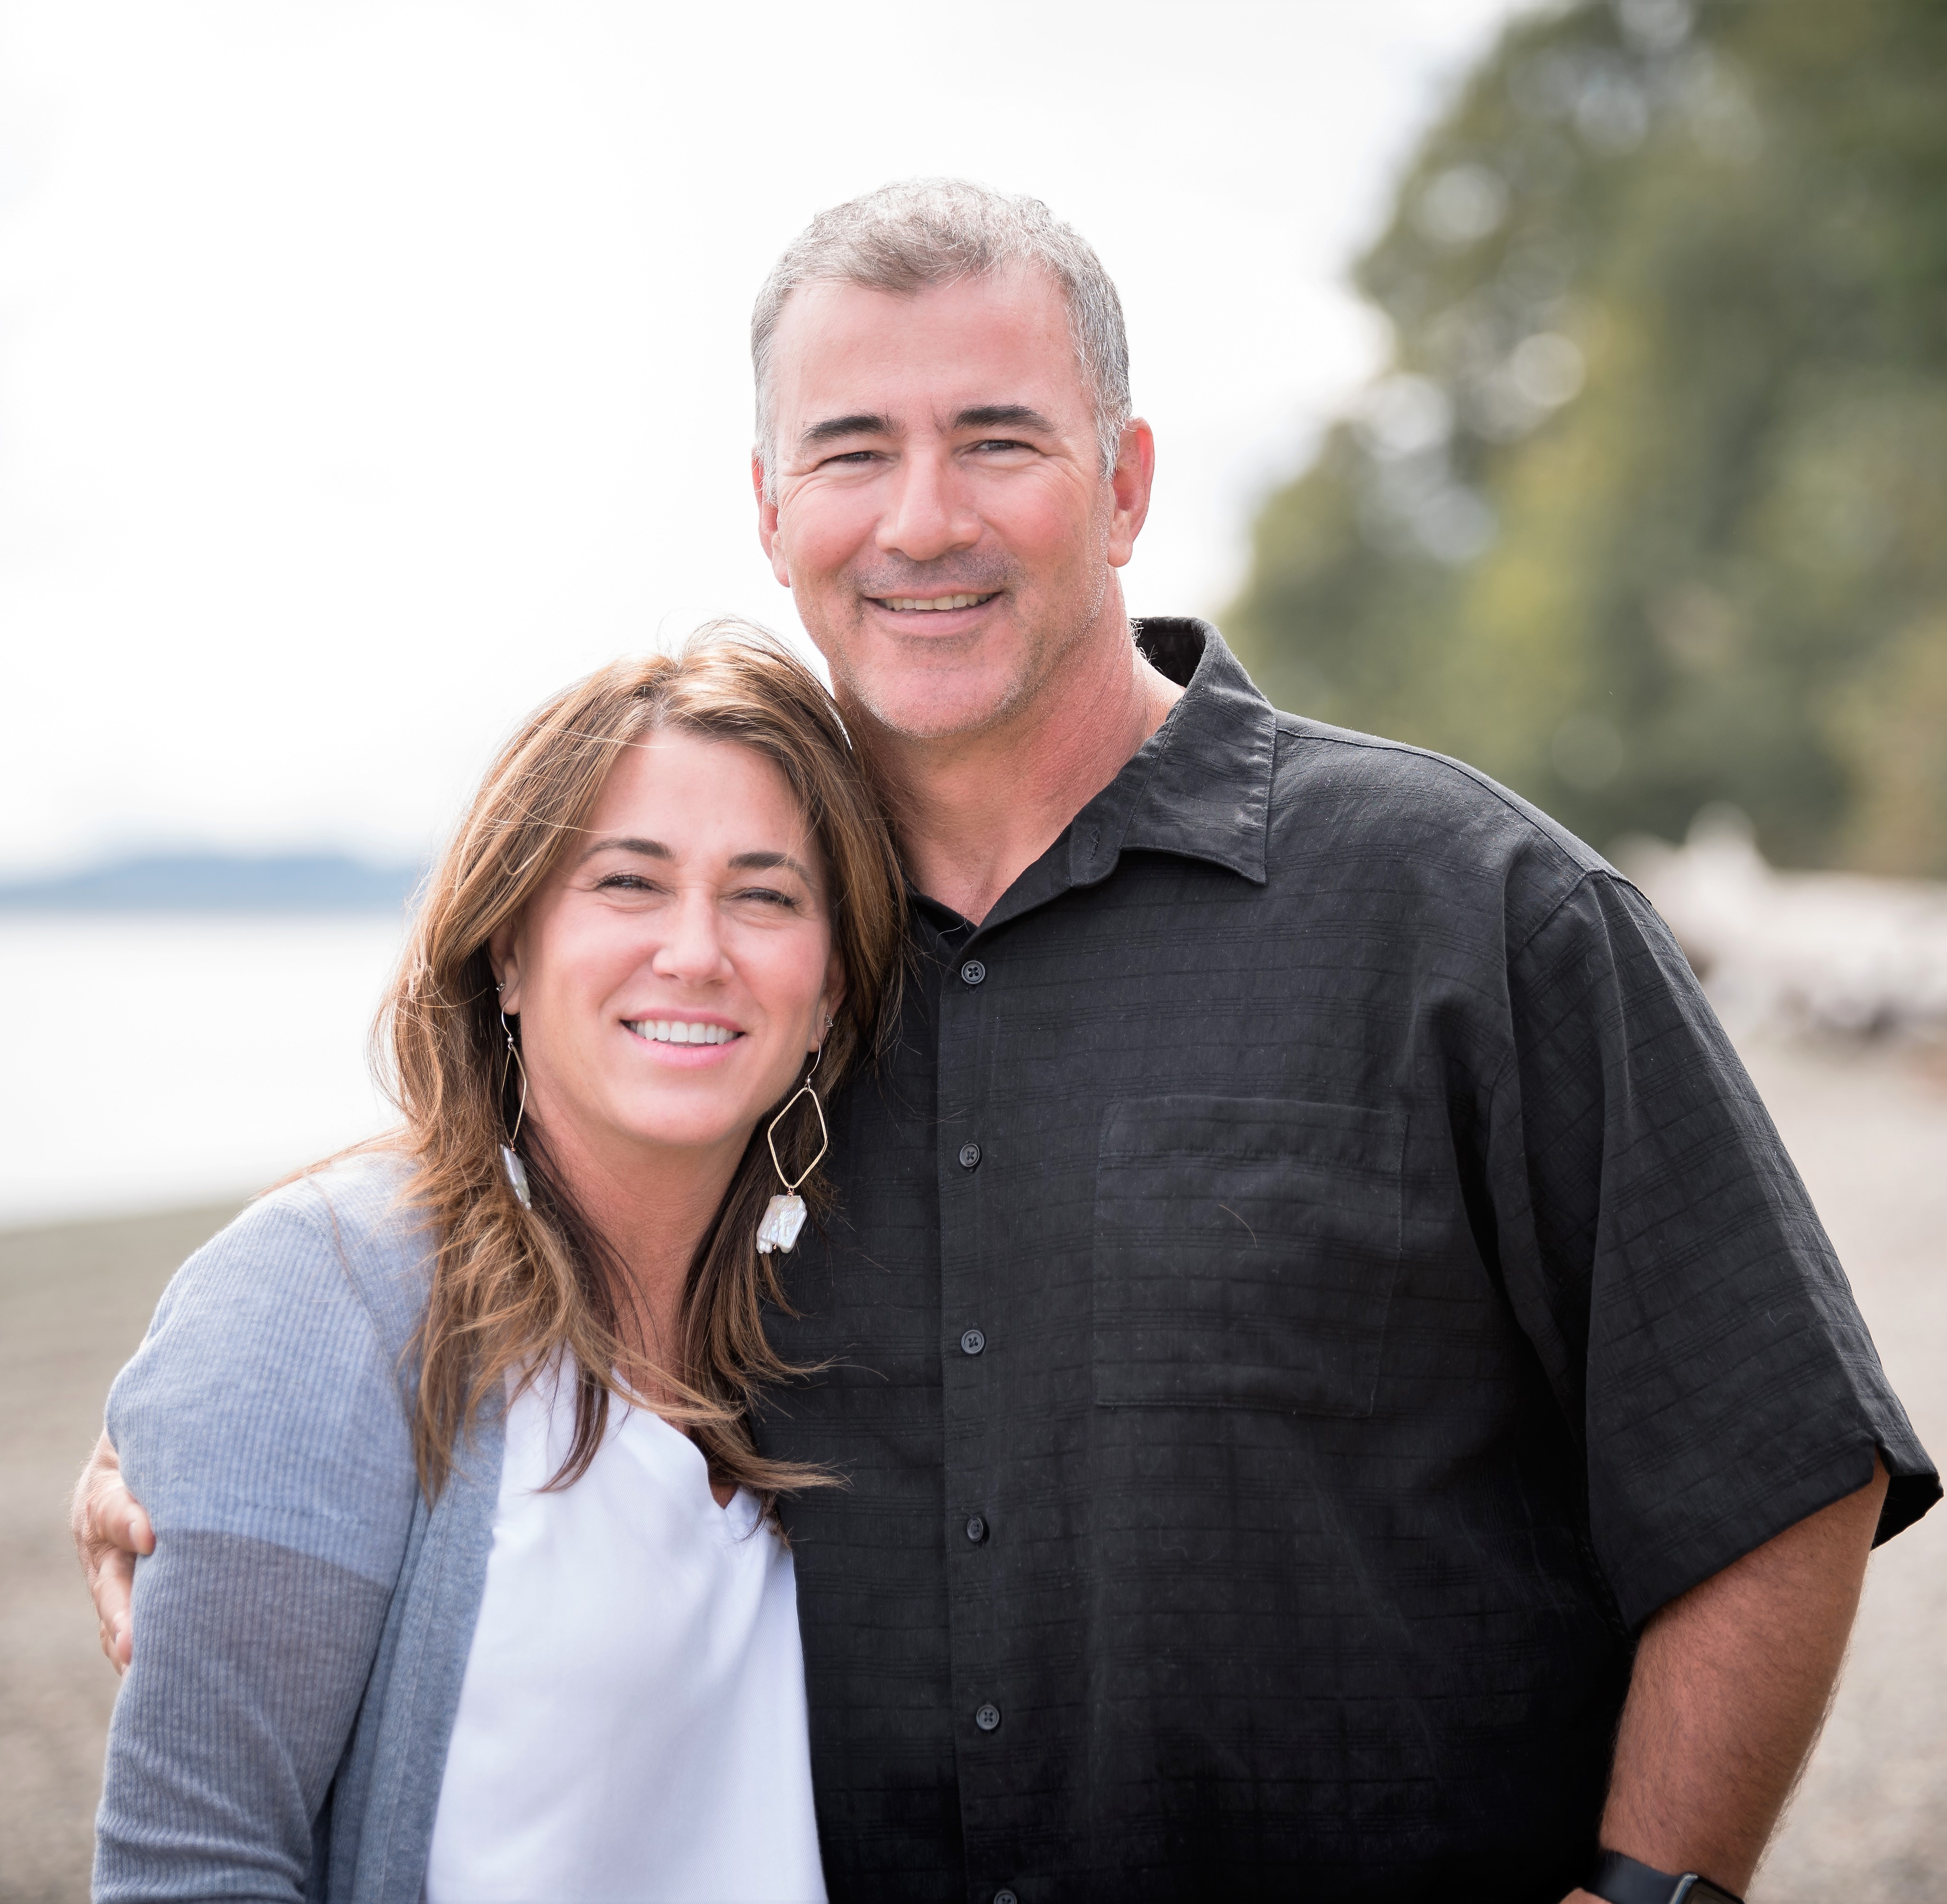
Happy Crew = Happy Customers = Happy Happy Owners$$$ Building Highly Performing Teams
My immediate working family!!!
Ann Farrell, MA
M.A. Applied Behavioral Science:
Organizational and Leadership Development
Director of Development & Training
Organizational Consultant & Team Building Coach
ESTB. 1995 8 locations
♥
Notes:
Welcome!! Thanks for joining me for this conversation on building vibrant working cultures and increasing your profits.
Everybody having a blast at the Expo?!?
So I wanted to talk for just a moment why I am qualified to talk about this important topic especially as it is applied to restaurants and pizzerias in particular….
Restaurant Business for 34 years: Family Business
Education
Evolution
Current Work: Farrelli’s and Boys & Girls
My passion is for seeing the best in people and helping them find the perfect place… helping them create A VSION FOR THEIR FUTURE… FARRELLI’S FUTURE AND THEN MAKING THAT COME TRUE.

Slide 3
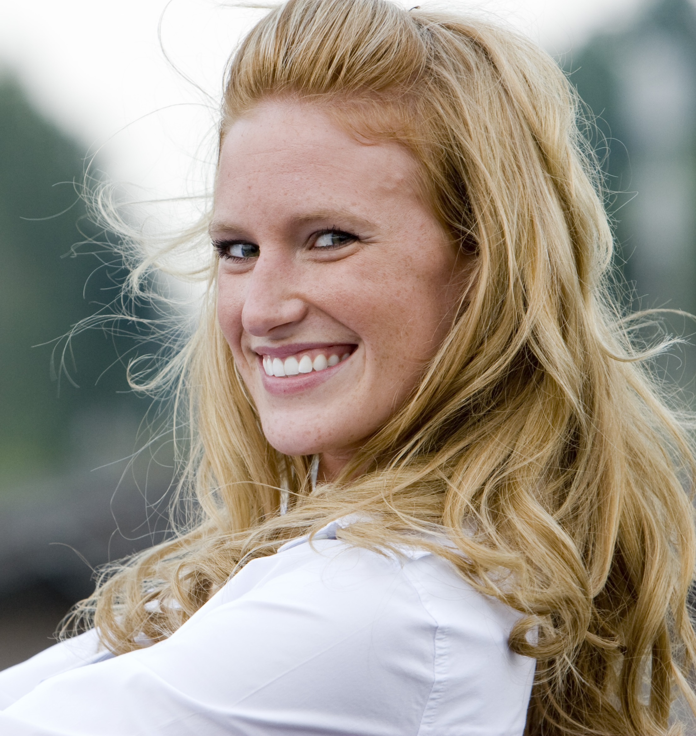
Happy Crew = Happy Customers = Happy Happy Owners$$$ Building Highly Performing Teams
Christal Spata
Christal Spata
Co-Owner and Operator
Valeo’s Pizza
Kenosha, WI
♥
Notes:
Welcome!! Thanks for joining me for this conversation on building vibrant working cultures and increasing your profits.
Everybody having a blast at the Expo?!?
So I wanted to talk for just a moment why I am qualified to talk about this important topic especially as it is applied to restaurants and pizzerias in particular….
Restaurant Business for 34 years: Family Business
Education
Evolution
Current Work: Farrelli’s and Boys & Girls
My passion is for seeing the best in people and helping them find the perfect place… helping them create A VSION FOR THEIR FUTURE… FARRELLI’S FUTURE AND THEN MAKING THAT COME TRUE.

Slide 4
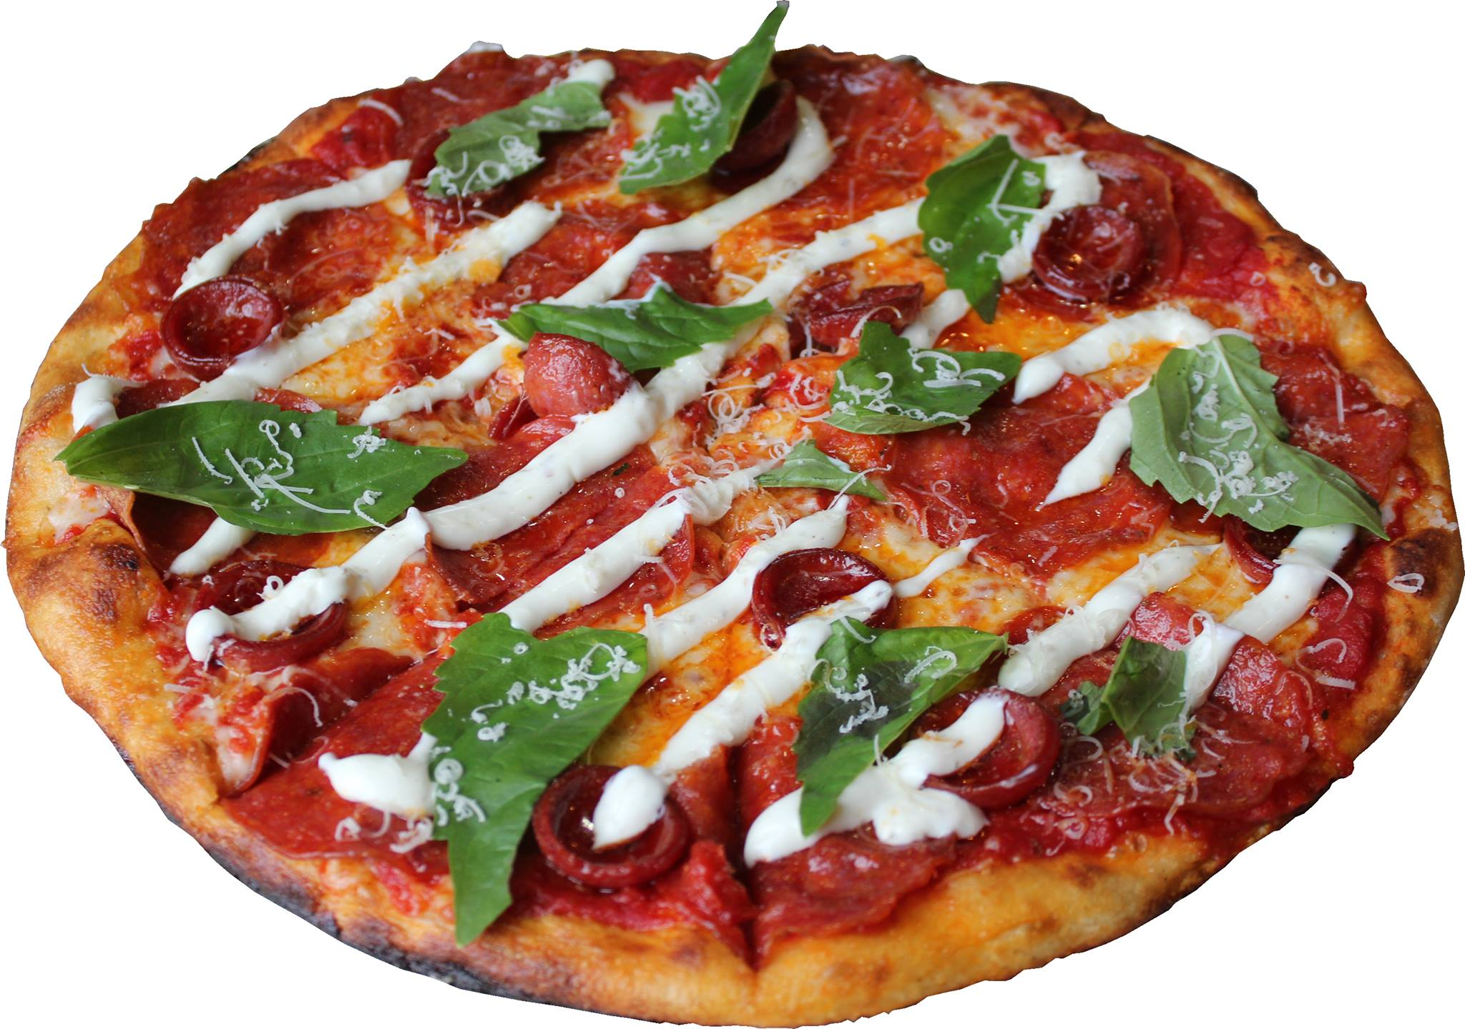
10 steps to take your pizzeria From Good to Incredible Building High Performing Teams
How it usually goes…
Be intentional about designing your pizzerias culture!
Articulate the WHY
Identify the HOW
Determine the WHAT
Maple Valley
Days Parade
!
Notes:
The First Three Steps
Need a vehicle to learn how to drive…
We have the vehicle first…. How is thinking of it and who aleready has one…
Where do you want to go…. What needs to be true to get where we we want to go….
Reverse engineer….
Why? 100 stores…. Huge vision… we want an empire…. That everyone wishes they could work at…. You get to the end of life…. Influencing and impacting people in a positive way….. 1st job, young people, restart, last chance… pivotal life changing moments…. To impact people when they are most moldable. Through pizza….
Went into so I create an opportunity to make an impact on people’s life…. That I mattered to people. I left the world the a better place
Had a destination not a map…. A feeling.

Slide 5
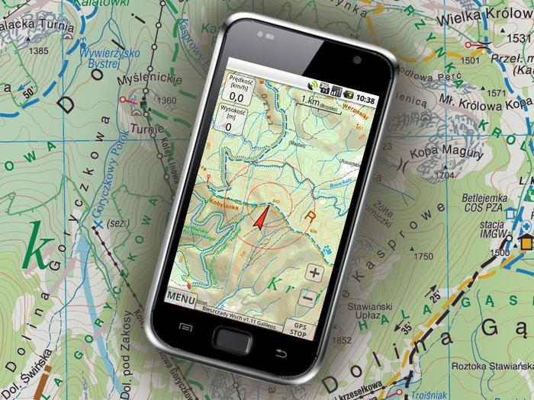
10 steps to take your pizzeria From Good to Incredible Building High Performing Teams
Set the gps – Where are you going and WHY?
Be intentional about designing your pizzerias culture!
Articulate the WHY
Identify the HOW
Determine the WHAT
Maple Valley
Days Parade
!
Notes:
The First Three Steps

Slide 6
10 steps to take your pizzeria From Good to Incredible Building High Performing Teams
#1
The why
Maple Valley
Days Parade
!
Notes:
Here is a quick outline of what we will be covering today. We will talk briefly about Role Clarity, setting clear expectations, and spend the majority of time focusing on building accountability by learning the strategies, tactics, and skills of giving great evaluation and timely feedback!
Culture is everything…. Say what you do and do what you say!!!

Slide 7
10 steps to take your pizzeria From Good to Incredible Building High Performing Teams
#2
The how
Maple Valley
Days Parade
!
Notes:
Here is a quick outline of what we will be covering today. We will talk briefly about Role Clarity, setting clear expectations, and spend the majority of time focusing on building accountability by learning the strategies, tactics, and skills of giving great evaluation and timely feedback!
Culture is everything…. Say what you do and do what you say!!!

Slide 8
10 steps to take your pizzeria From Good to Incredible Building High Performing Teams
#3
The what
Maple Valley
Days Parade
!
Notes:
Here is a quick outline of what we will be covering today. We will talk briefly about Role Clarity, setting clear expectations, and spend the majority of time focusing on building accountability by learning the strategies, tactics, and skills of giving great evaluation and timely feedback!
Culture is everything…. Say what you do and do what you say!!!

Slide 9
10 steps to take your pizzeria From Good to Incredible Building High Performing Teams
The Vehicle
How will you drive your business?
Warm clean welcoming space to work and patronize.
Excellent Systems and Processes
The tools, resources and equipment to get the job done!
Maple Valley
Days Parade
!
Notes:
The First Three Steps

Slide 10
10 steps to take your pizzeria From Good to Incredible Building High Performing Teams
#4
Maple Valley
Days Parade
!
Notes:
Here is a quick outline of what we will be covering today. We will talk briefly about Role Clarity, setting clear expectations, and spend the majority of time focusing on building accountability by learning the strategies, tactics, and skills of giving great evaluation and timely feedback!
Culture is everything…. Say what you do and do what you say!!!

Slide 11
10 steps to take your pizzeria From Good to Incredible Building High Performing Teams
#1
Maple Valley
Days Parade
!
Notes:
Here is a quick outline of what we will be covering today. We will talk briefly about Role Clarity, setting clear expectations, and spend the majority of time focusing on building accountability by learning the strategies, tactics, and skills of giving great evaluation and timely feedback!
Culture is everything…. Say what you do and do what you say!!!

Slide 12
10 steps to take your pizzeria From Good to Incredible Building High Performing Teams
#1
Maple Valley
Days Parade
!
Notes:
Here is a quick outline of what we will be covering today. We will talk briefly about Role Clarity, setting clear expectations, and spend the majority of time focusing on building accountability by learning the strategies, tactics, and skills of giving great evaluation and timely feedback!
Culture is everything…. Say what you do and do what you say!!!

Slide 13
10 steps to take your pizzeria From Good to Incredible Building High Performing Teams
The driver
How will you drive your business?
Be great leader!
Hire only the best!
The tools, resources and equipment to get the job done!
Learning & Growing is Fundamental for Everyone
Maple Valley
Days Parade
!
Notes:
The First Three Steps

Slide 14
10 steps to take your pizzeria From Good to Incredible Building High Performing Teams
#1
Maple Valley
Days Parade
!
Notes:
Here is a quick outline of what we will be covering today. We will talk briefly about Role Clarity, setting clear expectations, and spend the majority of time focusing on building accountability by learning the strategies, tactics, and skills of giving great evaluation and timely feedback!
Culture is everything…. Say what you do and do what you say!!!

Slide 15
10 steps to take your pizzeria From Good to Incredible Building High Performing Teams
#1
Maple Valley
Days Parade
!
Notes:
Here is a quick outline of what we will be covering today. We will talk briefly about Role Clarity, setting clear expectations, and spend the majority of time focusing on building accountability by learning the strategies, tactics, and skills of giving great evaluation and timely feedback!
Culture is everything…. Say what you do and do what you say!!!

Slide 16
10 steps to take your pizzeria From Good to Incredible Building High Performing Teams
#1
Maple Valley
Days Parade
!
Notes:
Here is a quick outline of what we will be covering today. We will talk briefly about Role Clarity, setting clear expectations, and spend the majority of time focusing on building accountability by learning the strategies, tactics, and skills of giving great evaluation and timely feedback!
Culture is everything…. Say what you do and do what you say!!!

Slide 17
10 steps to take your pizzeria From Good to Incredible Building High Performing Teams
#1
Maple Valley
Days Parade
!
Notes:
Here is a quick outline of what we will be covering today. We will talk briefly about Role Clarity, setting clear expectations, and spend the majority of time focusing on building accountability by learning the strategies, tactics, and skills of giving great evaluation and timely feedback!
Culture is everything…. Say what you do and do what you say!!!

Slide 18
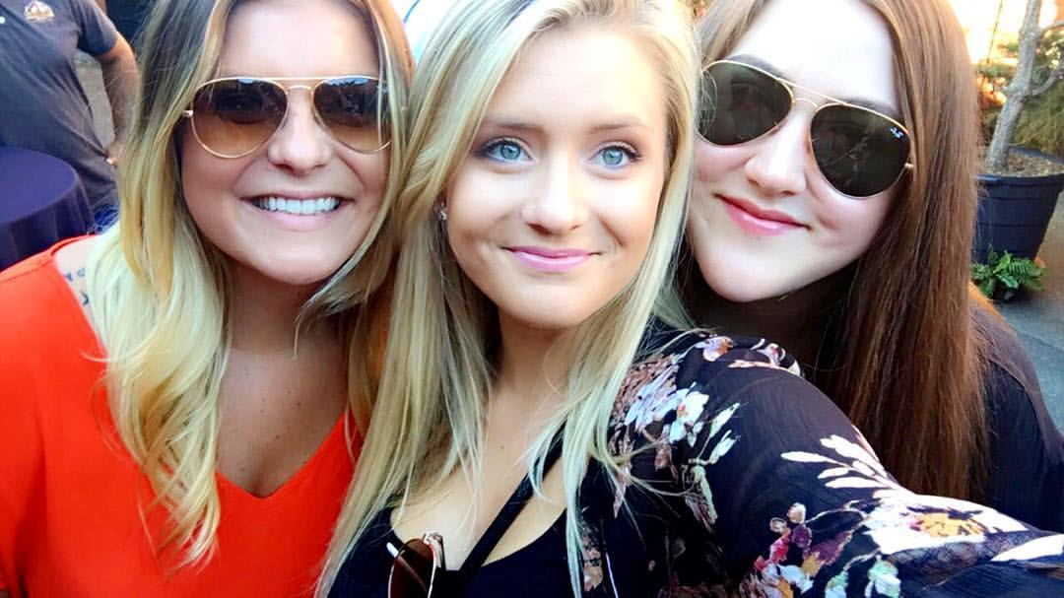
Happy Crew = Happy Customers = Happy Happy Owners$$$ A very common story!!
From mediocre to the Highly performing Wolf-Pack.
From Wolf-Pack to frustration.
And back again!
Emilie
11 years
Jessie
5 years
Chelsea 11 years
General Managers for Farrelli’s – All Started as Hosts
!
Notes:
CULTURE IS FLUID….. It responds to moods … it can change fast or it can erode of become exceptional quickly. Culture takes on the personality of it’s leader. It happens whether your consciously build it or let it just happen.
Culture is everything…. Say what you do and do what you say!!!
Jessie grew from within… started as a host…. Became a GM a couple years ago and inherited the position from a GM whose was great but who really wanted to try his hand at a more 9-5 type a job. His wife didn’t like restaurant work
He’d had shorttimers for a while…. He let his culture slip and he really wasn’t getting the result we wanted. So Jessie steps in and she is this beautiful smart ambitious woman with a ton of personal power…. Everyone loved her and loved woking with and for her. She was so excited to create a strong team and prove that her location could achieve all of our business goals. She created the WOLF PACK….. And they killed it!!!
Work 40-45 hours a week
Post Schedule on the Office Door so people knew when she planned to be there
Eliminate all triangulation from the building
Document all employee issues…..
6 Months ago Jessie fell in love, got a Mastif dog who needed to be taken out for a walk every afternoon, and had a sister who was really suffering with anxiety….
She started relying on her management support team to cover for her…. The location continued to get an amazing business result but morale started slipping…… the shadow side of loyalty kept our senior leadership team unaware that her work ethic was slipping—her team protected her. And she had a problem employee…. One who having marriage problems was coming to work oveerlyu emotional, who was having serious coflicts at work with team embers. After a particularly bad shift the GM decided she was going to terminate employment… she felt like she had given
enough feedback to

Slide 19
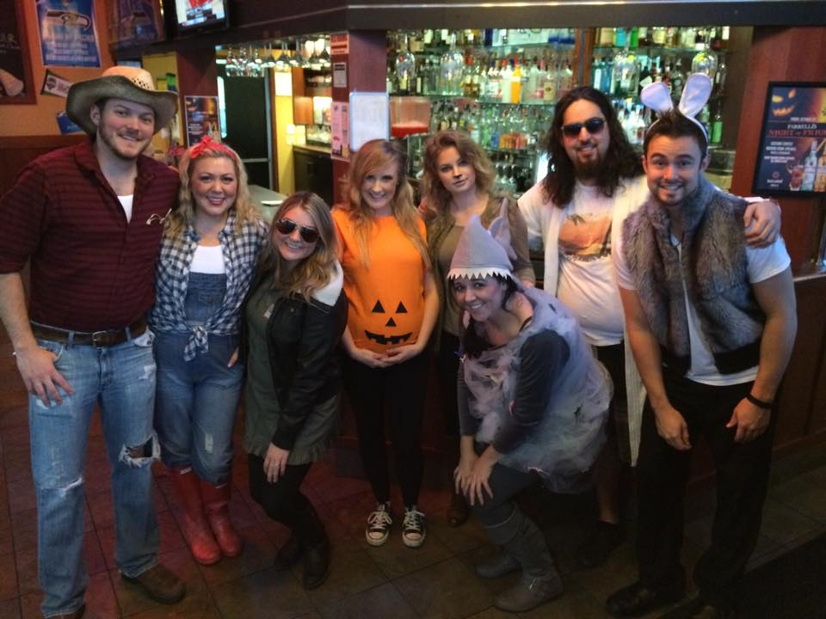
Happy Crew = Happy Customers = Happy Happy Owners$$$ Culture is EVERYTHING
Culture is like the air we breathe.
It is the shared values, beliefs, and behaviors that are characteristic of a particular social group.
Having fun working on Halloween
Did you intentionally build the culture
you have in your pizzeria or did it just happen?
!
Notes:
Tell that story of origin… RUI, Jacque getting roped in…. Success… me getting roped in Success… Then copies of copies…. And getting to go to school and learning the theory of why what we did intuitively worked and how we needed to build the culture with intention so that we could predictably repeat what we had done twice… and that we could teach others how to do it and hold them account able to thinks like integrity, quality, growth, passion, fun, and responsibility….because we defined it! We created a compass with our mission statement so that when things got rough and they do get rough we can go to our values and mission and let them guide the way to the best decisions for our organization and family.
This is the foundation for EVERYTHING…. Your food, your environment, the people you hire, how you manage and lead them, and the people you will end up serving in the community.
Whether you have been intentional about creating your working culture or not… you have a culture. Generally takes on the personality of the strongest leader…. All the good and all the not so good.
So important to be aware of what the culture is
Be intentional: Create the culture you want. Define it though values, guiding principles, a compelling mission, and a clear vision. Acknowledge where you are strong and successful… and where you aren’t. And fix what isn’t serving the mission.
Hire only the very best: Make sure the values of your team match the values of your business.
Good Business Systems: Keep honest people honest. Keep Score!
Clear Expectations and Great Training!!
Strong Effective Leadership: Provide 1-4, Gratitude--Great leaders give all the credit to their team for success and take all the blame for failure. Lead by example and you with have a successful business and a GREAT WORKING CULTURE!!

Slide 20
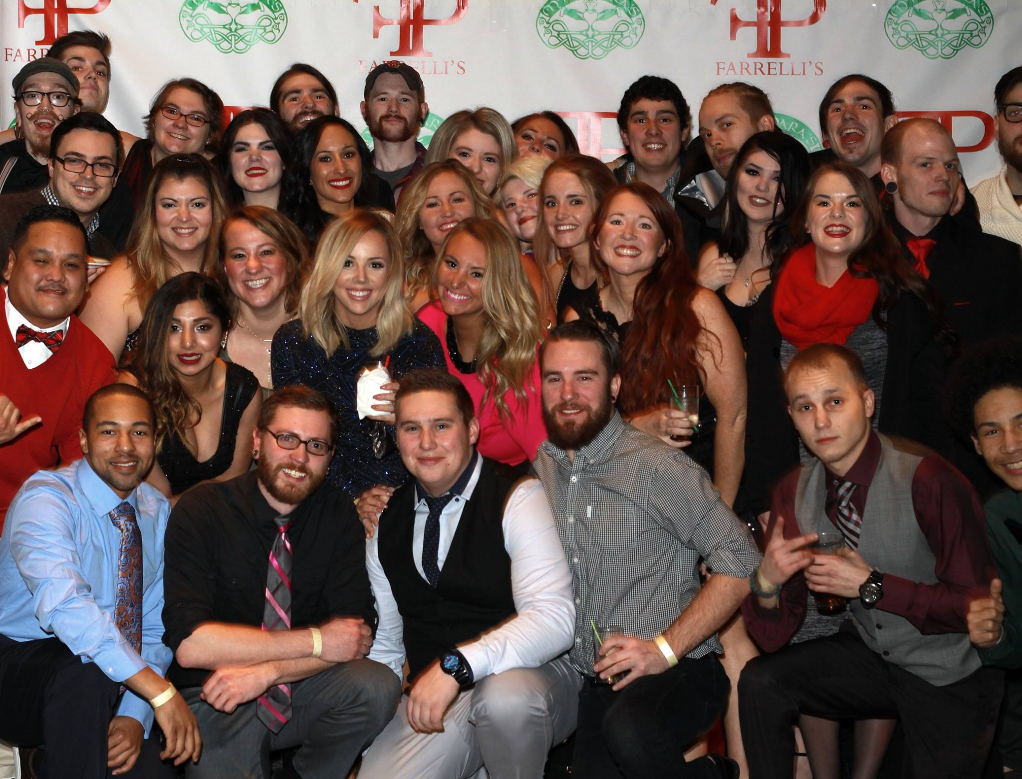
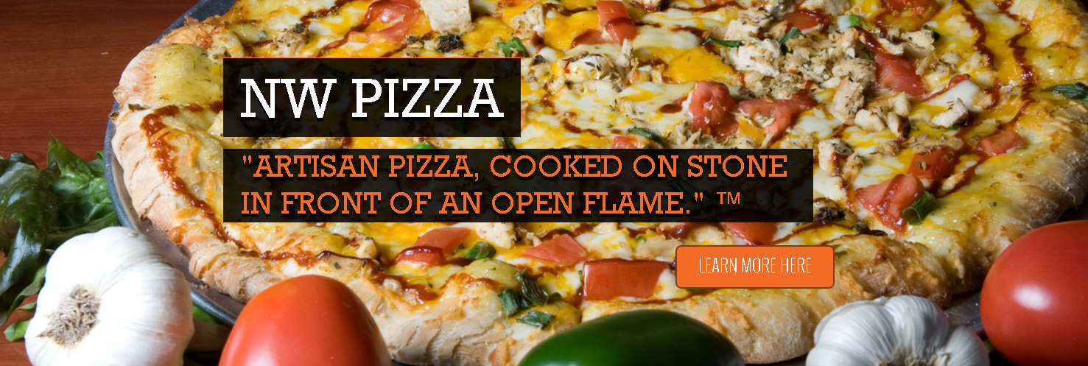
Culture is EVERYTHING
Be out loud with your why!!
What is your pizzeria’s WHY?
WHAT is it you do?
HOW do you do it?
Holiday Party 2015
!

Slide 21
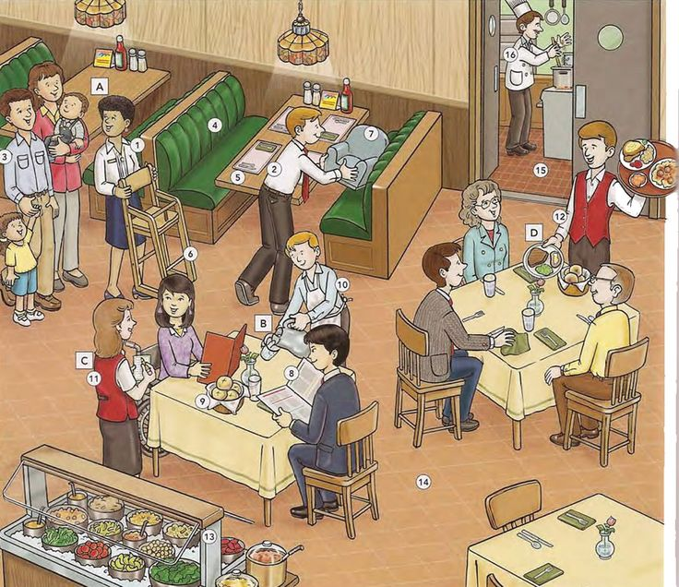
ROLE CLARITY:: Everyone knows who is responsible for what
ROLE CLARITY
If its everyone's job it’s no ones’ job!
!
Notes:
By a show of hands how many people here have very specific job descriptions and expectations detailed for all positions?
To hold people accountable you have to first have set standards by which to hold them accountable and these must be written and clearly communicated.
Job Descriptions: Specific and Detailed including compensation.
Managers: General Manager, Kitchen Manager, Supervisors, Leads
Prep, line cooks, dishwashers
Host, busser, server, bartender, cocktails
A well run restaurant is a high functioning team with 2-3 sub teams that must all work seamlessly together… Kitchen, Dining Room, Delivery Drivers, and Bar (if you have one).. Nothing will bring a Friday night to a screeching halt is a break down in any one place within the team. So know who is supposed to be doing what is critical.

Slide 22
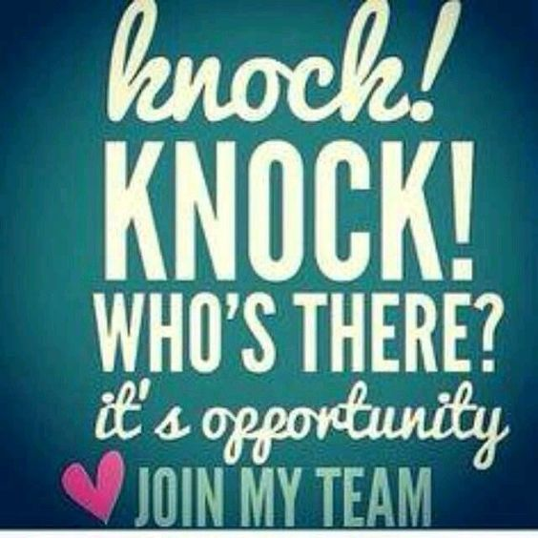
Job descriptions & Competencies
ROLE CLARITY:: Everyone knows who is responsible for what
Use language that is aligned with your mission and values.
GENERAL DESCRIPTION: Summarize the reason the job exists
REPORTING STRUCTURE: Eliminates confusion.
LEADERSHIP EXPECTATIONS: We all lead ourselves. Things like professional image. Taking responsibility for professional growth and development.
MANAGEMENT RESPONSIBILITES: Could be a section or a station, the team, business results
WEEKLY PRIORITIES
WORK LIFE BALANCE COMMITMENT
COMPENSATION
!
Notes:
Bring a copy of job descriptions. To show them as examples

Slide 23
Farrelli’s Heart of the Team
Fair Transparent Compensation
Encourages Pizza Makers to be in charge of their own destiny.
Pizza Makers hold our leaders accountable for their Growth!
!

Slide 24
Set CRYSTAL CLEAR EXPECTATIONS
WHAT YOU PERMIT YOU PROMOTE
People respect what you Inspect not what you expect
Working Culture
Pattern of Management
Attainable Goals: Labor, Paper, Food, Liquor, Beer, Wine
Incentives & Discipline
Reliable Sales Forecasts
Side Work Lists
Server Sequence & Kitchen Timings
!
Notes:
PEOPLE EARN THEIR TERMINIATION WITH FARRELLI’S
Pattern of Management
Attainable Goals: Labor, Paper, Food, Liquor, Beer, Wine
Reliable Sales Forecasts
Working Culture
Side Work Lists
Kitchen Timings
Server Sequence
Incentives & Discipline

Slide 25
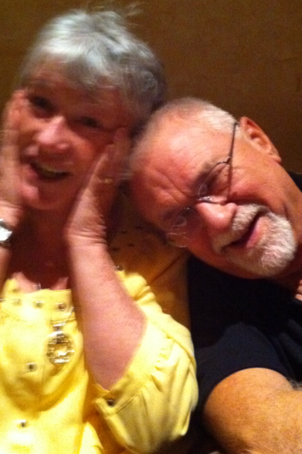
Set CRYSTAL CLEAR EXPECTATIONS
How many hats do the people on your team wear??
We are Fathers, Mothers, Spouses, Daughters, Aunties, Sisters, Brothers, Nieces, Partners, and Friends who are CEO, COO, Managers at every level of the organization, and crewmembers. It gets messy… AND (most days)WE LOVE IT!!
!

Slide 26
Accountability: People Earn their Termination
Avoiding Pain
Progressive Discipline
Verbal Warning
Written Warning
Extra Duties: Pulling gum from under tables and other cleaning chores
Loss of shifts
Suspension
Termination: Promoted to Customer, Made Available to Industry
Pursuing Pleasure
Peer Pressure for EXCELLLENCE
Professional Image
NO Cell phones on shift
Compliance with all standards
Recognition for Top Performers
Frequent THANK YOUs!
Preferred Schedules or sections
Bonus, gift cards, swag from vendors and tickets to events.
!
Notes:
Clarrissa Pinkola Estes… PhD Dangerous Old Women
Eccentricity is a sign of a gifted person…. Normal is the enemy of exceptional
Working ON your business instead of IN your business

Slide 27
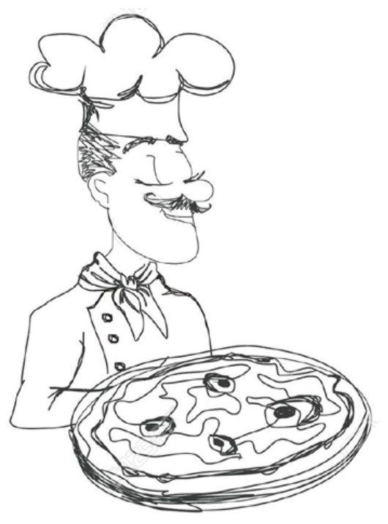
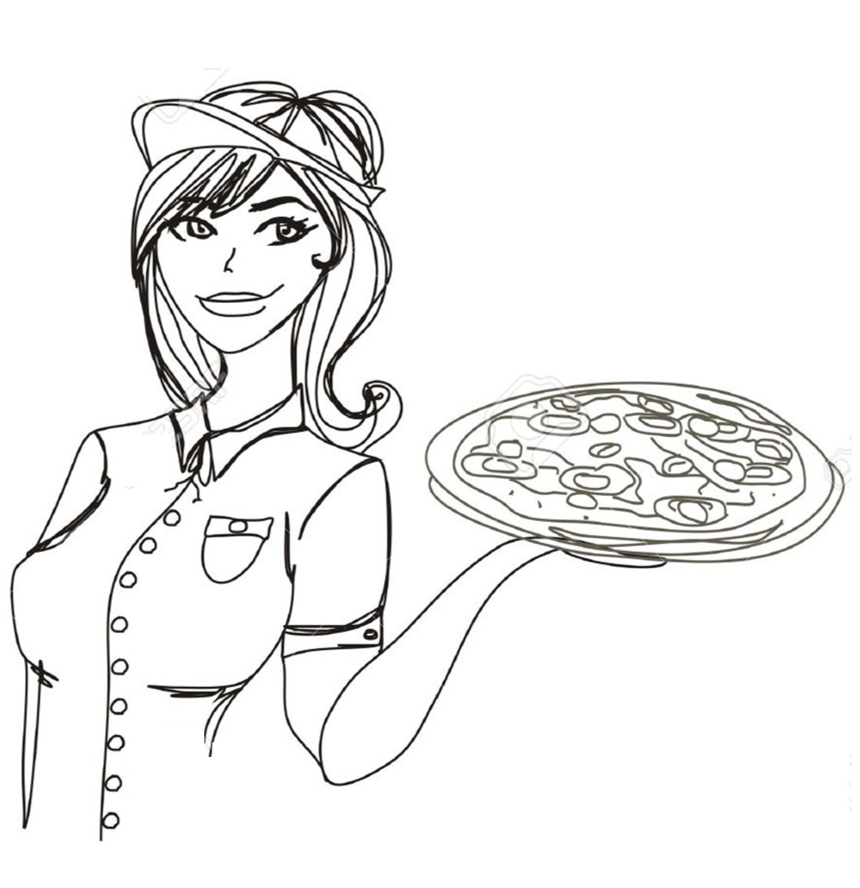
COMMUNICATION is keY
"We judge ourselves by our intentions and others by their impact.” John Wallen
ENCODING
Chef communicates intentions into words and actions based on his life experience, values, and beliefs.
DECODING
Server interprets message—An educated guess based on her life experience, values, and beliefs
INTENTIONS
Private and often unclear even to self.
WORDS & ACTIONS
Public
IMPACT
Private… Unless Pizza maker asks or Server shares.
The Interpersonal Gap
We are meaning making machines
And perception is not always reality
!
Notes:
Tell that James Text message story…
How many times across the line between server and cook do we have conflict. It is the most common frustrating dynamic that can ruin a fun busy night and tip everyone over…. Especially if you have people with anger issues!!
So the Lead Pizza Maker yells…. Hey, Ann the window is full… get your servers to get this food out of the window!!! His intentions are to achieve ticket times and make sure our guests get their pizza at it’s best…. Hot out of the window.
The observation I make is that Mike is moving really fast, sweating and yelling….and has what I would call a really intense look with his brow all furrowed and eyes squinting. the Meaning I make is he is mad at me… he thinks I am incompetent at running the floor and he is unreasonable and mean.
What he observes is me rolling my eyes and hussling to get food out of the window.
The impact is that I am mad that he would dare to yell at me…. My feelings are hurt and I can’t wait to unload on someone anyone about what a jerk he is!

Slide 28
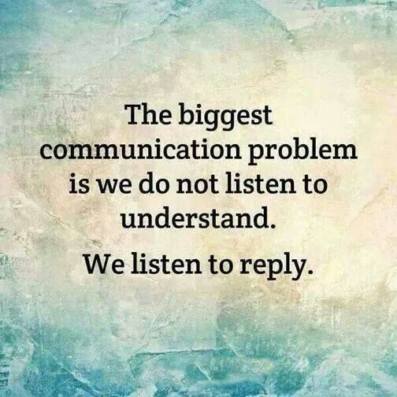
Tell the truth - COMMUNICATION is keY
Honesty is the most direct path to mental health!
Jim Moats a mentor of mine.
Cultivate Genuine Curiosity
ACTIVELY LISTEN
Communicate Your INTENDED Message and check for IMPACT
!
Notes:
The greatest gift you can give to another is taking the time to listen to the other as if they are an honored guest in your home
Engage in active attentive listening (eye contact, body language).
Ask Clarifying Questions.
Paraphrase. Mirror back to the person how you think thy might be feeling (perception checking).
Make sure the person knows you have truly heard them.
Be very clear about what message you want to send and the impact you want to have.
Don’t attack a person’s character—share the observable behaviors that you have seen, heard, experienced.
Ask what is going on (only if you really care) and then share the impact of behavior and result or consequences.
This may take time up front that you don’t think you have…. But it will builds the most important thing you can have between people. TRUST….
A GM asking for a raise but has not earned it yet…. She was meeting the numbers objectives but had done it more through fear and intimidation that leadership…. The morale in her store was low…. As evidenced by higher turnover than normal for us, people overstepping her to talk to me about her management style and hurt feelings….. She also had an attitude that every guest was out to GET US vs really sharing a bad experience and needing to be taken care of.
She was doing so many things right…. But again…. In our culture we have to have both the business result accomplished in healthy positive culture that builds and develops people and build loyal guests.

Slide 29
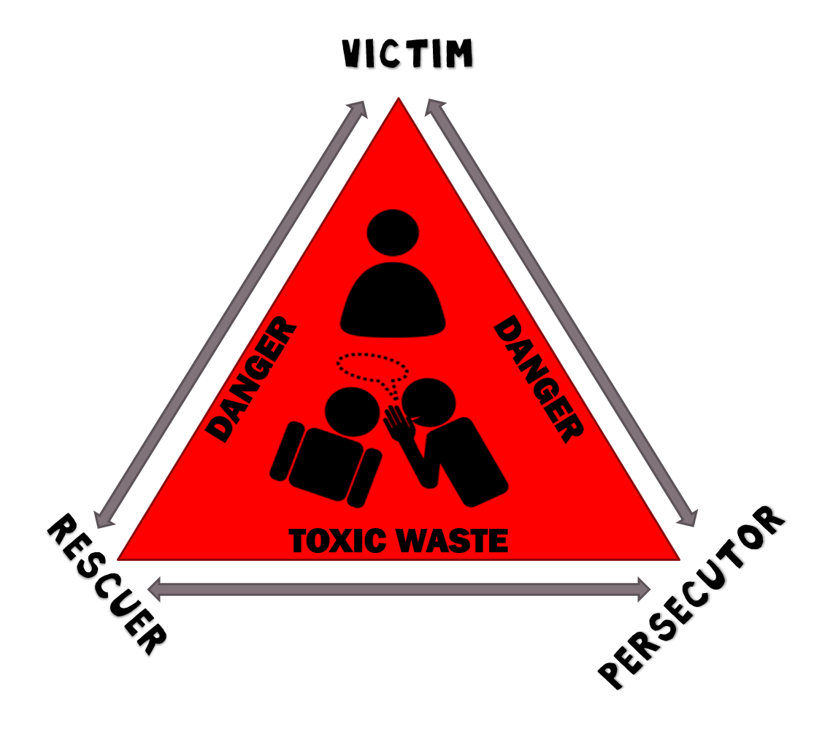
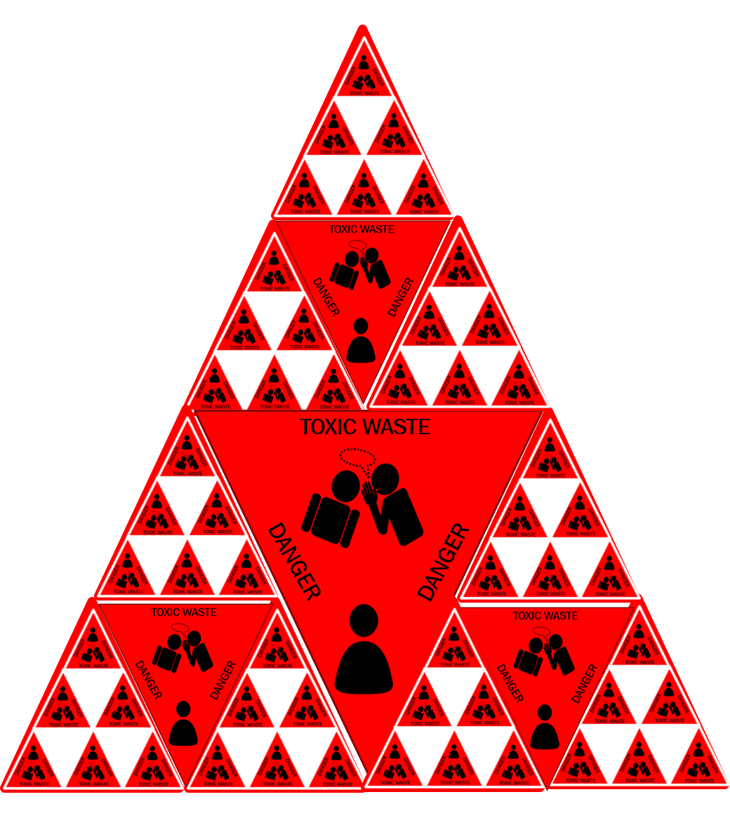
Triangulation & Gossip = Organizational Cancer
C
Triangulation creates an unhealthy passive aggressive culture
Undermines trust, honesty and integrity.
B
A
I began to realize that the quality of conversations is not only indicative of the culture. It create culture, and it determines the quality of the decision-making, planning, everything.” -Ken Macher

Slide 30
EVALUATIONS, FEEDBACK, AND coaching
People don’t care how
much you know until they
know how much you care.
Feedback should NEVER be a surprise!
Critical feedback is given as close to “real-time” as possible!
How often should you give general feedback evaluations?
How often should you give a formal evaluation?
♥
Notes:
Back to role clarity when managing friends and family and trying to give feedback! Making sure that when you are trying to have a professional conversation you are intentional about your hats… I am not your mom right now I am the director of development or I am the mentor of this store accountable for the results you achieve and …..
Helping people manage their anxiety around their identity issues….
How often should people be evaluated:
let’s be honest we are all evaluating judging and assessing every single day!
So it’s really a matter of how often do you share those thoughts in a constructive way.
For Example: (Ug… why did she just roll out of bed and come to work.
She looks like she doesn’t care at all! But I don’t want to hurt her feelings…
she has to be nice to people all day and I don’t want her to start the shift crying because I was hard on her.)

Slide 31
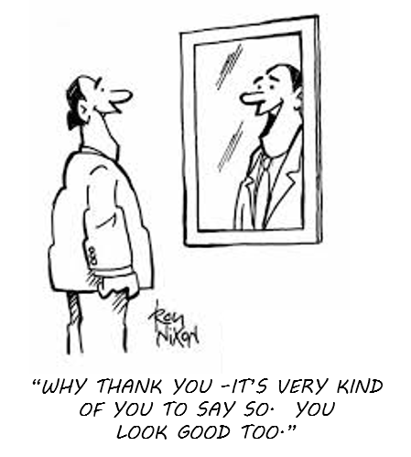
Tell the truth - COMMUNICATION is keY :
Take the time to do
Self-evaluations first!
People know how they are doing.
Make it safe to tell the truth!
Be curious and ask questions.
Tell your truth and move quickly.
Problem solve and create and action plan.
!
Notes:
MIRRORS SHOW US WHAT WE LOOK LIKE NOT WHO WE ARE
Self evaluation: Back to the story about one of locations: The girl who was having all the problems with the GM and her team. I needed her to be able to tell me how she had contributed to the problem. I needed her to hold up the mirror and tell me what she saw in terms of her work and the working relationships she was a part of.
She owned her emotional intensity. Her tendency to take things personally and react in a hostile way.
She owned that she was a part of a click that triangulated.
For example: if the expectation for is for professional image include uniform and grooming. Standards. Ask on a scale of 1-5 how they think they are doing. Same for timeliness, menu knowledge, service sequence, food timings, teamwork… etc.

Slide 32
Tell the truth - COMMUNICATION is keY
REAL TIME FEEDBACK
Is the most powerful
BE GENUINE & Curious
BE POSITIVE
Be behaviorally specific Share your experience. I saw, heard, smelled, tasted… ☺
GIVE BOTH POSITIVE AND Critical Feedback
!
Notes:
Real Time THANK YOUs: You look very professional today! The food looks amazing! Great job keeping the dining room spotless and detailed! Table 5 said the food was great and service was awesome. Thank you!!
Real Time Critical Feedback: Hey just a reminder… you need to pre-bus table 10. This pizza is light (or heavy) on toppings can you work on following the recipe! Hey, I was just in the bathroom as host it is your responsibility to get in there every 15 minutes and make sure the toilets are flushed, counters are wiped off, and all paper towels are in trash and pushed down! You look overwhelmed… what help do you need? Let's talk later tonight about what went wrong!

Slide 33
Tell the truth - COMMUNICATION is keY:
TYPES OF FORMAL & INFORMAL FEEDBACK
Do This
3+
3-
?
5 min check-in when shift starts
2 min check-in when they clock off
In the moment!
Formal Evaluations
Compensation Evaluation
Builds trust, performance,
sales, and profitability
!
Notes:
Real Time THANK YOUs: You look very professional today! The food looks amazing! Great job keeping the dining room spotless and detailed! Table 5 said the food was great and service was awesome. Thank you!!
Real Time Critical Feedback: Hey just a reminder… you need to pre-bus table 10. This pizza is light (or heavy) on toppings can you work on following the recipe! Hey, I was just in the bathroom as host it is your responsibility to get in there every 15 minutes and make sure the toilets are flushed, counters are wiped off, and all paper towels are in trash and pushed down! You look overwhelmed… what help do you need? Let's talk later tonight about what went wrong!
QUESTIONS TO ASK
Is there anything you need to let go of to have a great day today?
What support do you need to give your team your best today?
What are the 3 ways you excel at your job everyday, the last week, month year?
What are the 3 thing you could do to improve your performance?

Slide 34
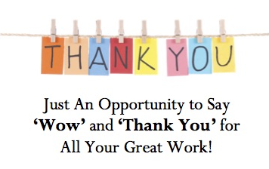
Appreciation - Gratitude - Incentives
Genuine Appreciation
Growth Opportunities
Learning Fieldtrips
$5 Thank You Cards
Gift Card Trades
Distributor Swag & Hook-Up!
Special Appreciation Events
Builds trust, performance,
sales, and profitability
!
Notes:
Genuine Appreciation: Frequent Thank Yous
Growth Opportunities: Better shifts, more hours, promotions with increases in wages.
Learning Fieldtrips: Win-Win fun and improves crew members knowledge and pride and passion for the work they do inside the 4 walls and word of mouth on the street
$5 Farrelli’s Bucks with John’s Face on them
Trading with local business whack cost us basicallth the food cost at about 25%
Swag, concert, and sporting event tickets from beer, wine, and spirit distributors.
Yearly Christmas Ball

Slide 35
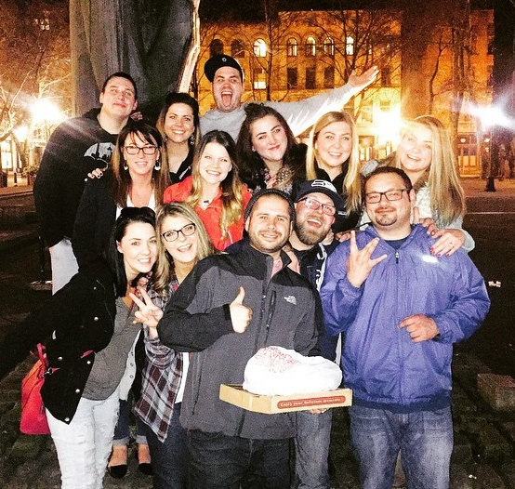
Happy Crew = Happy Customers = Happy Happy Owners$$$ Building Highly Performing Teams
Culture is EVERYTHING
Everyone knows who
is responsible for what!
Always tell the truth
Practice Appreciation
Learning adventure
in seattle
Any questions???
!
Notes:
Here is a quick outline of what we will be covering today. We will talk briefly about Role Clarity, setting clear expectations, and spend the majority of time focusing on building accountability by learning the strategies, tactics, and skills of giving great evaluation and timely feedback!
Culture is everything…. Say what you do and do what you say!!!

Slide 36
Happy Crew = happy customers ________________________________ happy happy owners $$$
How to Build High Performing Teams
#1
Ann Farrell, MA
Partner & Director of Development
ann@farrellispizza.com
PowerPoint: farrellispizza.com/ann

